Slide 1


Machine Learning for Downtime Prediction
STAT606 Practical Assignment
Binary Classification: Maintenance Requirement Prediction
By Yanga Ndamase (226029024) & Mawanda Mbaza (226024595

Slide 2
Raw Downtime Data
Data Cleaning,
Target Definition & Preprocessing
Feature Engineering
Machine learning Techniques
Models evaluation & Best Model Selection
Feature Importance
Conclusion
Contents flowchart
From raw downtime data to model evaluation

Slide 3


Brief introduction to the data and problem
Dataset
We are using the iportal_downtimes dataset from manufacturing operations.
The dataset contains machine downtime events (features) from PLC in roborts such as:
downtime duration
fault duration
plant
department
area
downtime type
failure reason
machine messages
timestamps
Each row represents a machine downtime incident.
This will help:
reduce production downtime
prioritize maintenance teams
improve operational efficiency
Business Problem
The objective is to predict whether machine downtime/failures require maintenance using EMEA plants historical downtime logs.
Goal: Reduce unplanned downtime through early identification of maintenance needs.
Binary classification problem: MaintenanceRequired (0/1)
Target Variable:
MaintenanceRequired
Mantainance Required | Target
Yes | 1
No | 0

Slide 4
Data Understanding, Preprocessing & Feature Engineering
Duplicate removal: unique(df) used to eliminate repeated downtime records & bias in model learning.
Handled missing numeric values: imputed using median (robust to outliers).
Handled missing categorical values: replaced with 'Unknown' category so model can still learn from them.
Fixed NaN and infinite values before modelling our data in H2O environment
High-cardinality identifiers removed (e.g., DowntimeId) to reduce noise.
Removed leakage variables used in target construction (e.g. DowntimeType), Class order was enforced (levels = c("0","1")) ,Numeric conversion + median imputation were also used.
Remove identifier columns that do not contribute to prediction
Feature Engineering (Purpose: Improve model ability to capture operational behaviour patterns)
Target creation: based on median downtime threshold + failure keywords.
New features: Hour extracted from timestamp, DayOfWeek derived from DowntimeStartDatetime.
EmergencyFlag created using keyword detection (emergency, critical, urgent) from DowntimeDescription

Slide 5
Machine Learning Techniques
Three classification techniques were applied are as follows:
Decision Tree (interpretable rule-based model)
Implemented using Random Forest with a small number of trees for stability
rpart was used for visual interpretation of tree structure & to display fitted tree information
Logistic Regression (linear baseline model)
To captures linear relationships in downtime behaviour
Naive Bayes (probabilistic independence model)
For assuming conditional independence between predictors in our model

Slide 6
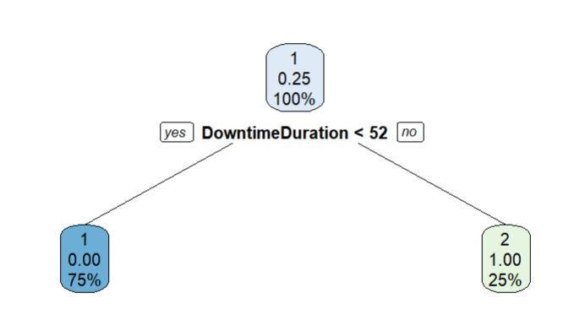
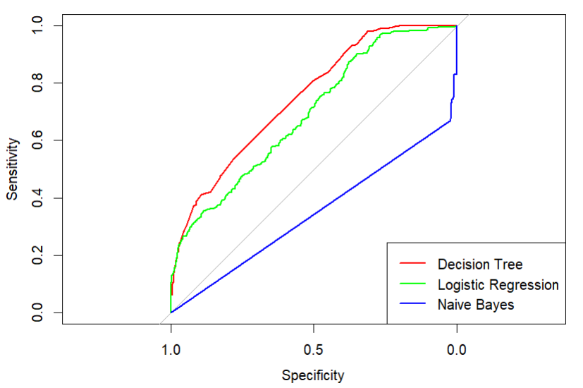
Model Evaluation & Results
Used 70:30 split ensuring class representation.
Best Model Selection :
Evaluation metric: AUC (Area Under Curve) - We use AUC instead of F1 because : - downtime data is often imbalanced
The Decision Tree achieved the highest AUC - proving the strongest predictive performance on the held‑out test set and the Best bias- variance trade-off
Logistic Regression showed lower performance, with mild underfitting, as its linear structure limited its ability to capture non‑linear and threshold‑based patterns in maintenance behaviour.
Naïve Bayes performed poorest – Underfits the data, due to violations of the conditional independence assumption after data cleaning and leakage removal. Results in high bias and weak ROC performance.
Decision Tree
Notes:
Based on AUC evaluated on a held‑out test set, the
Decision Tree achieved the best predictive performance (AUC ≈ 0.7495) & shows the strongest ROC performance, indicating the strongest overall discriminative ability.
Logistic Regression showed moderate performance, constrained by its linear modelling assumptions. In contrast,
Naïve Bayes exhibited weak generalization after data cleaning and leakage removal, suggesting that its conditional independence assumption was not well suited to the final feature set.
High sensitivity achieved with better separation of classes.
Consequently, feature importance and key drivers of maintenance were interpreted primarily using the Decision Tree and supported by Logistic Regression. The results further demonstrate that feature engineering substantially improved predictive power, with downtime severity, time‑based patterns, and operational context emerging as the primary drivers of maintenance requirements.

Slide 7
Model Interpretation Results
Model | Observed Performance (ROC/AUC) | Bias/ Variance | Interpretation in the project.
Decision Tree | Highest AUC; strongest ROC curve separation. | Balanced bias-variance trade off | Best generalization model. Captures interactions effectively. No clear evidence of over fitting due to controlled model complexity.
2. Logistic Regression | Moderate AUC; ROC above Naïve Bayes but below the Decision Tree. | Moderate bias, low variance | Mild underfitting. The linear structure cannot adequately model non-linear and threshold-based maintenance patterns.
3. Naïve Bayes | Lowest AUC; ROC curve closer to diagonal | High bias, low variance | Strong underfitting due to conditional independence assumption. Results in a weak discriminative ability.

Slide 8
Top 5 most important features
Top predictive features (Decision Tree):
- Downtime Duration
- Fault Duration
- Emergency Flag
- Downtime Type
- Hour of occurrence

Slide 9
Conclusion
This project demonstrated how machine learning can be applied to operational downtime data to predict whether a downtime event requires maintenance intervention.
Through robust data preprocessing, target variable construction, and feature engineering, meaningful operational patterns were successfully extracted.
Three classification models — Naïve Bayes, Logistic Regression, and Decision Tree — were evaluated using AUC, which is appropriate for the imbalanced nature of maintenance data.
The Decision Tree emerged as the best‑performing model, achieving the highest test‑set AUC and the best bias–variance trade‑off, while Logistic Regression and Naïve Bayes underfit due to restrictive modelling assumptions.
Feature importance analysis showed that downtime duration, fault duration, emergency indicators, downtime type, and time‑based features are the primary drivers of maintenance requirements.
Overall, the results highlight potential benefits of reduced unplanned downtime, improved reliability, and more efficient use of maintenance resources.

